Slide 1
Painter by Numbers
Se Oh
7/20/2017

Slide 2
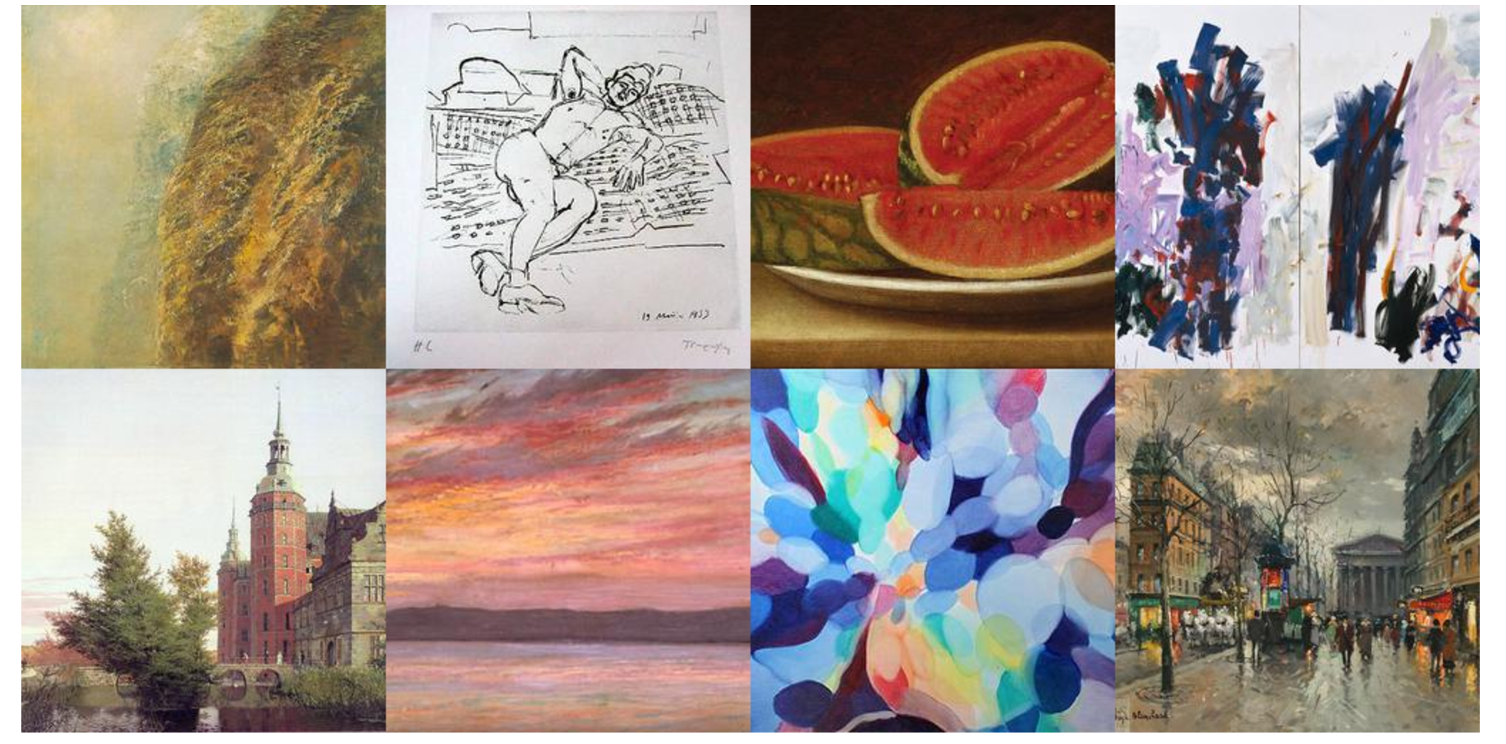
Data
The data is obtained from the Kaggle competition “Painter by Numbers”. The training data includes 79433 painting from 1584 artists in JPG format. I used about 25% data from original image for training and testing.

Slide 3
Challenges
Training data size
Experiment setup
Fit suitable model
Resizing photo (Shape)
Unexpected error from google cloud

Slide 4
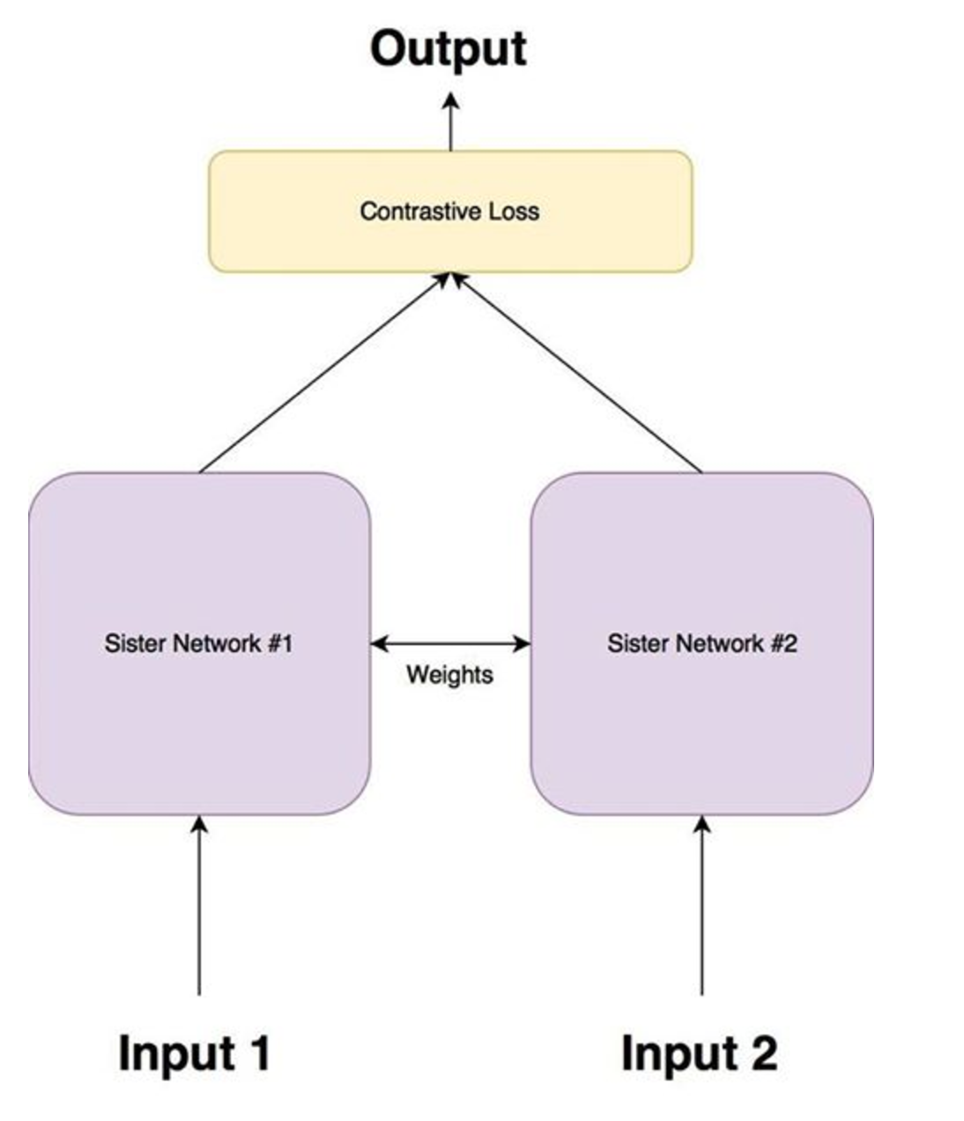
Environment
Google cloud GPU Tesla K80
Train on 19000 samples, validate on 10000 samples
Keras
Convolution Neural Network (Siamese Network)
Reference:https://www.cs.cmu.edu/~rsalakhu/papers/oneshot1.pdf
Notes:
대비 손실 함수(Contrastive Loss function) siamese 아키텍처의 목적은 입력 이미지를 분류하는 것이 아니라 이미지를 구분하는 것입니다. 따라서 분류 손실함수(classification loss function)(cross entropy와 같은)가 가장 적합하지는 않습니다. 대신 이 아키텍처는 대비 함수(contrastive function)를 사용하는 것이 더 적합합니다. 직관적으로 이 함수는 네트워크가 주어진 이미지 쌍을 얼마나 잘 구별하는지 평가합니다.

Slide 5
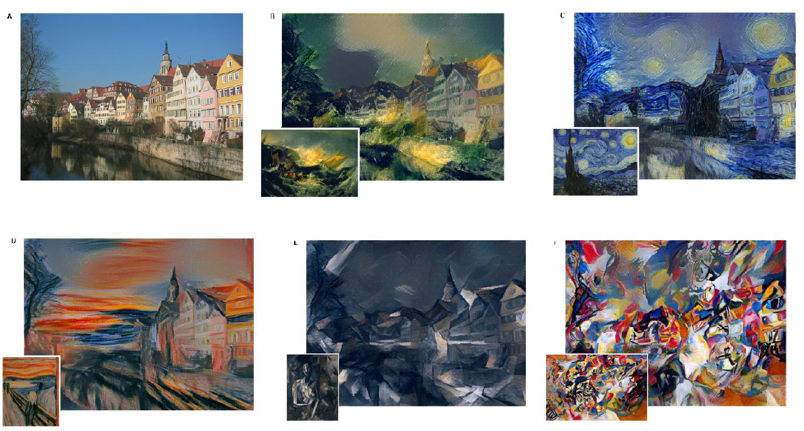
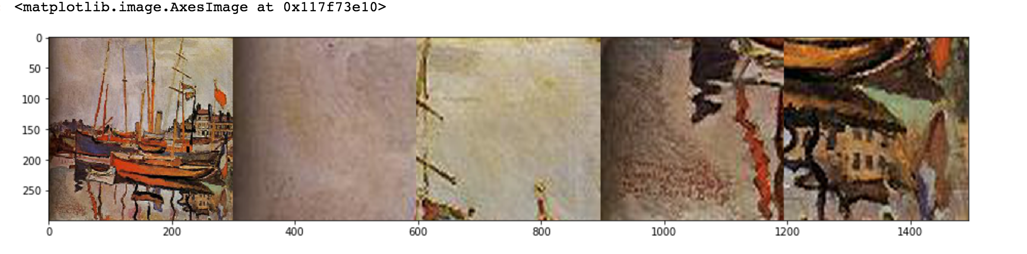
Artistic Style Transfer
“Image Style Transfer Using Convolutional Neural Networks”

Slide 6
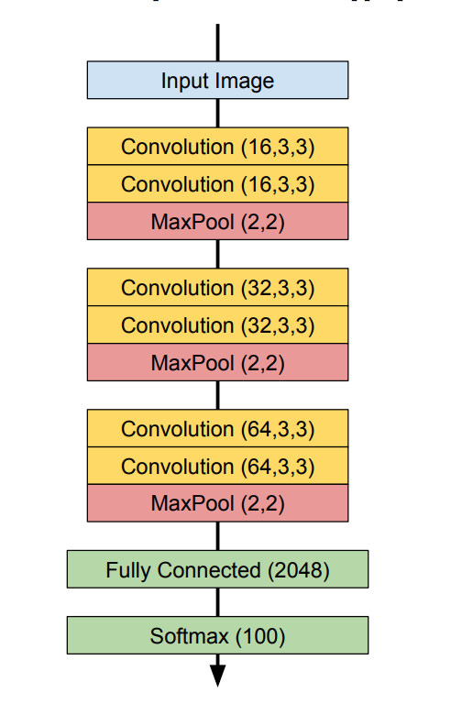
Architecture
Batch normalization
Dropout
L2 Weight penalty
Zoom corner
Notes:
The following convolutional neural network architecture
was used to train a classifier that predicts the
artist label on individual paintings. Then we use the
output of the network as a feature vector, and use
cosine similarity for final classification. Batch Normalization
and Dropout were used as appropriate.
Depiction below illustrates the architecture of the final convolutional neural network with non-linearities, dropouts and batch normalization layers omitted. 3x3 convolutional filters with stride 1 are used to produce feature maps, that are two neurons smaller along each of the two dimensions, than their input volumes. Zero padding is then used to retain the original shape and 2x2 max pooling with stride 2 halves the number of neurons along each of the two dimensions. Non-linearities are applied to convolution and fully connected outputs using the PReLU function (Leaky ReLU with trainable slope parameter in the negative part). Dense layers at the end of the architecture are the reason why fixed-size inputs need to be fed to the network. The model is regularized using dropout, batch normalization layers and L2 weight penalties 1. 학습 데이터 전체가 아닌 batch 단위로 DW를 하고, 각 layer별 logit들이 그 대상이다. (activation 전에 batch normalization 수행)
2. DW는 먼저 batch의 평균을 빼고 표준편차를 나눠주는 정규화과정이 있다. (학습 대상 없음, layer별로 batch평균/표준편차 하나씩만 구하면 됨)
3. 정규화된 데이터에 대해서 각 뉴런 별로 scale, offset을 적용한다. (각 뉴런 별로 2개의 학습 대상이 되는 파라미터 존재)

Slide 7
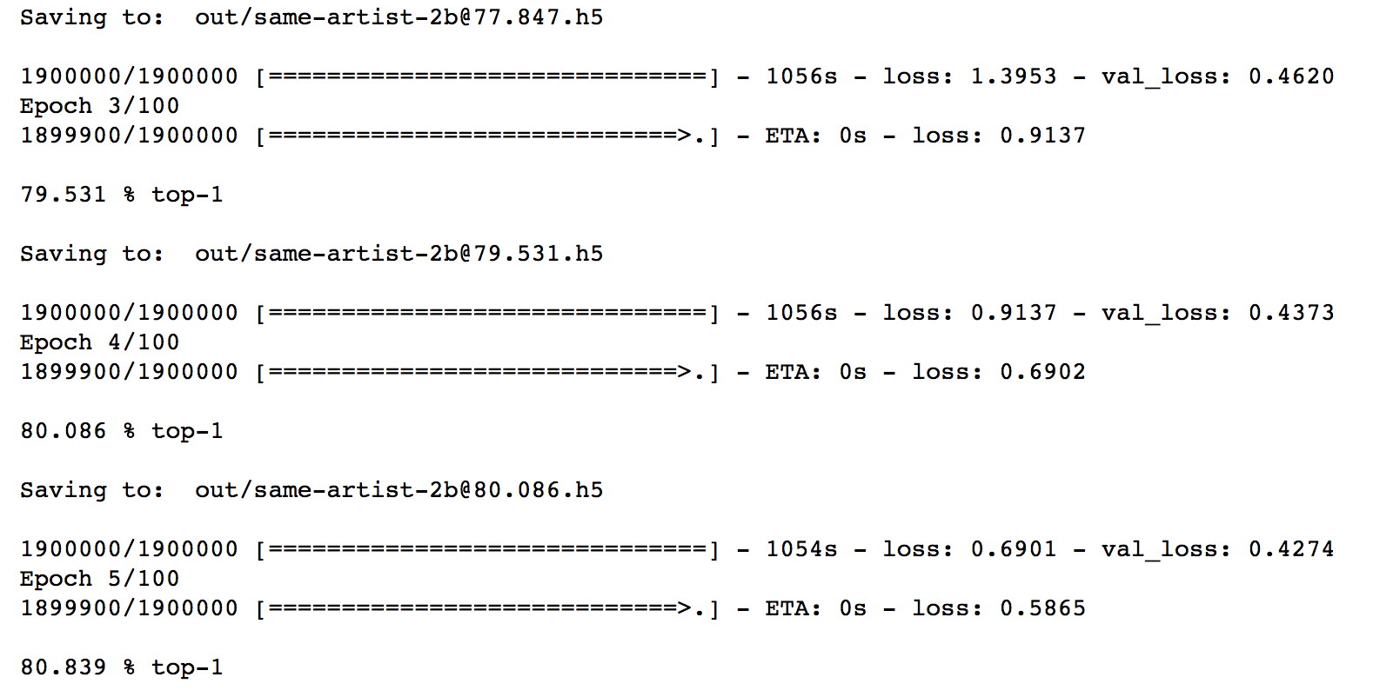
Parameter
300 epoch 2.4 learning rate
cross-entropy loss was minimized
Random forest ACC 59%

Slide 8
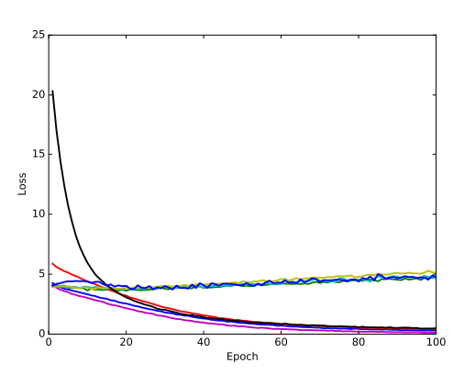
Result
Plot of Train/Validation

Slide 9
Conclusion
Siamese network with VGG Net 16
Painter recognition is fundamental in many applications.
Low accuracy can be improve by parameters
Class balancing was most challenge such as each epoch, and batch-balancing.
I believe this project was totally necessary because I can’t tell the different between paints.
If I had two more weeks I would like to improve accuracy.

